Slide 1
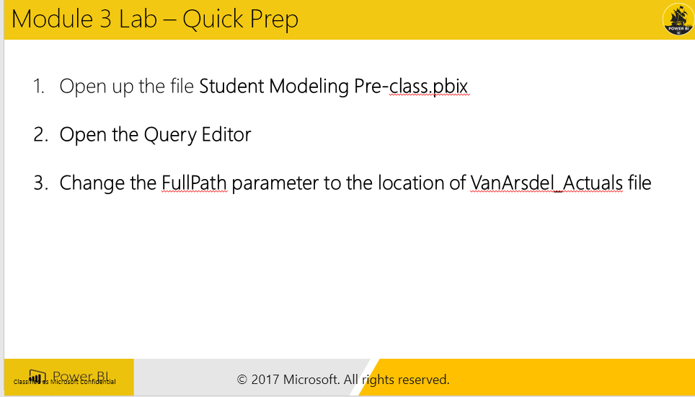
Step by Step
Objective – Add Sales Amount
Go to Query Editor
Change the full Path Parameter to the location of the VanArsdel Actuals excel file
Go to Sales Query, and click on Merge ProductDim on ProductID
Expand Unit Price
Add Custom Column – Sales Amount =
Unit Price * Units
Remove Unite Price
Change Sales Amount to Currency
Close
DimGEO
Split City before Delmiter
Before first comma
Student Notes

Slide 2
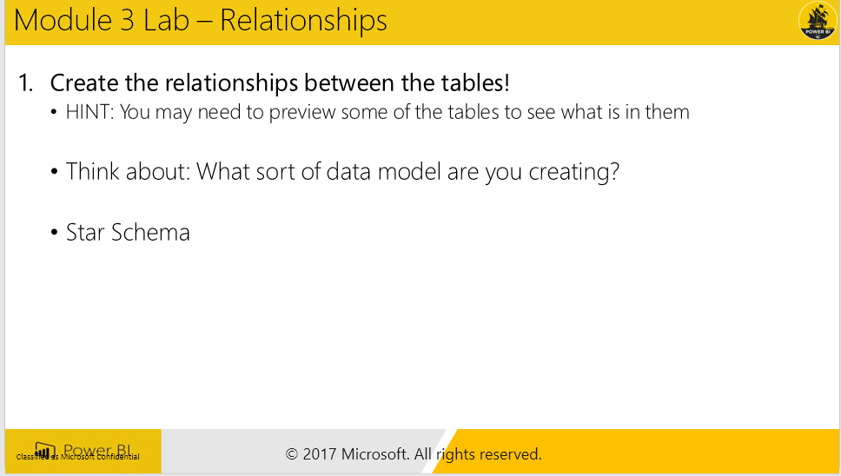
Step by Step
Objective: Create the Relationshps
Sales * ← 1 ProductDim
Sales * ← 1 DateDim
Sales * ← 1 CampaignDim
Sales * ←→ 1 CustomerDim
CustomerDim * ←→ 1 GeoDim
Student Notes

Slide 3
Step by Step
Go to Data View and go to Sales Table
Choose create calcuaated column
SumOfSalesAmount = SUM (Sales[SalesAmount])
Explain why this did not work
Student Notes

Slide 4
Step by Step – Columns vs. Measures
Objective: Create Measures & Columns
Create Price Band Column in ProductDim:
Price Band = If(ProductDim[Unit Price] <=25, "Low",If(ProductDim[Unit Price] <=50, "Medium", "High"))
Create same(NewColumn) in Query Editor
Open Query Editor
if [Unit Price] <= 25 then "Low" else if [Unit Price] <=50 then "Medium" else "High“
Student Notes

Slide 5
Step by Step
Create COGS column in Sales Table
Sales[COGS] = RELATED(ProductDim[Unit Cost]) * Sales[Units]
Create City State column in Sales
Sales [City State]= RELATED(GeographyDim[City]) & “, ” & RELATED(GeographyDim[State])
Student Notes

Slide 6
Step by Step
Objective – Show Default Summarization
Add a Combo clustered chart
Add an Implicit Measure of Sales Amount from Sales
Add Category from ProductDim as Bar Chart
Drag CustomerID from Sales to the Line Value
Click on arrow on CustomerID, choose Distinct Count
Go to Modeling Ribbon – Lets add Unique Count of Customers
Student Notes

Slide 7
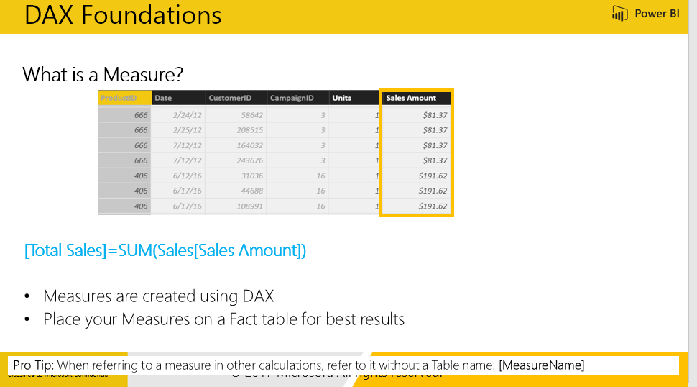
Step by Step
Objective: Add New Measures
Create a Measure Table
Click on new Table
Create Total Sales Measure
Total Sales = SUM(Sales[Sales Amount])
Change Data Type to Currency in Modeling Ribbon
Hide the Column1 and collapse/expand the Fields ribbon
Create COGS measure
[Total COGS] = SUM ( Sales[COGS] )
Create Profit
[Profit] = [Total Sales]- [Total COGS]
Profit Margin % = Divide(Profit, COGS)
Student Notes

Slide 8
Step by Step
Desktop Sales
Use Calculate =
[Desktop Sales] = CALCULATE([Total Sales], CampaignDim[Device] = "Desktop")
[Tablet Sales] = CALCULATE([Total Sales], CampaignDim[Device] = “Tablet")
[Mobile Sales] = CALCULATE([Total Sales], CampaignDim[Device] = “Mobile")
Student Notes

Slide 9
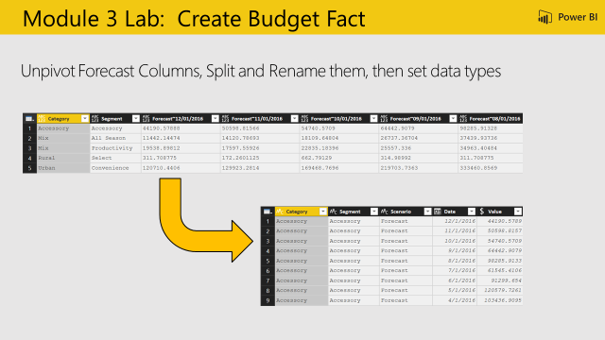
Step by Step
Objective: Create the Budget Fact
Highlight [Category] and [Segment] and Transform > Unpivot Other Columns
Highlight [Attribute] and navigate to Home > Split Column > By Delimiter > “~”
Rename: [Attribute.1] = “Scenario”, [Attribute.2] = “Date”, [Value] = “Budget Amount”
Change the Data Types: [Budget Amount] = Fixed Decimal, [Date] = Date
Student Notes

Slide 10
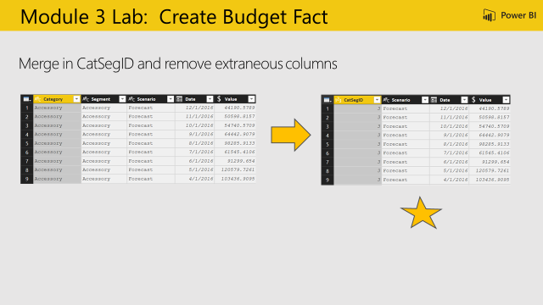
Step by Step
Objective: Merge the queries together to create the final Budget Fact table
Home > Merge Queries > Select CatSegDim
From the CatSegDim highlight both [Category] and [Segment]
Go back up to BudgetFact, highlight both [Category] and [Segment]
Show the Join Kinds available, and leave “Left Outer”
Expand [NewColumn] > Select “CatSegID” and deselect “Use Original column name as prefix”
Remove: [Category], [Segment]
Reorder: [CatSegID], [Scenario], [Date], [Budget Amount]
Disable the load of BudgetFact_Data
Student Notes

Slide 11
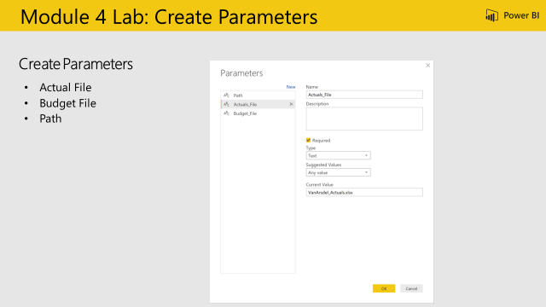
Step by Step
Objective: Update file paths to use dynamic variables
From the Home Ribbon > Manage Parameters
Create a new Parameter
Parameter Name: Path
Type: Text
Current Value = C:\Power BI_Adv_M\
Create a new Parameter
Parameter Name: Actuals_File
Type: Text
Current Value = VanArsdel_Actuals.xlsx
Create a new Parameter
Parameter Name: Budget_File
Type: Text
Current Value = VanArsdel_Budget.csv
Update the text files to ensure the parameter names are consistent
Student Notes

Slide 12
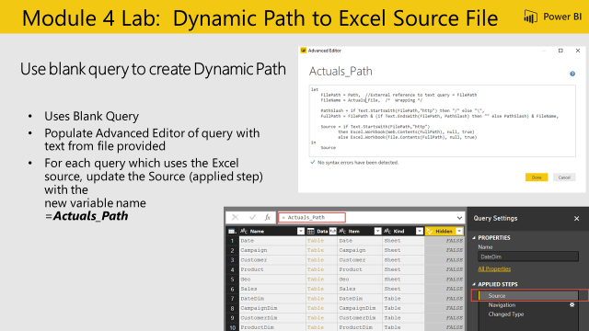
Step by Step
Objective: Create a query to validate if source is Web or Local and resolve path
Create a new blank query
Query Name: “Actuals_Path”
Text as shown in slide (white box)
Update Source Applied Step to use Resolved Path = “Actuals_Path” to the following Queries:
CampaignDim
CustomerDim
ProductDim
CatSegDim
DateDim
GeoDim
SalesFact
Student Notes

Slide 13
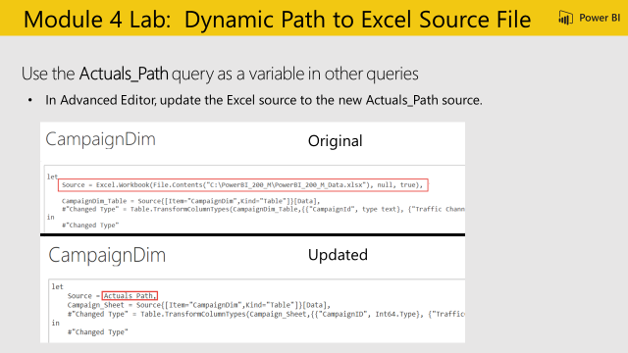
Step by Step
Student Notes

Slide 14
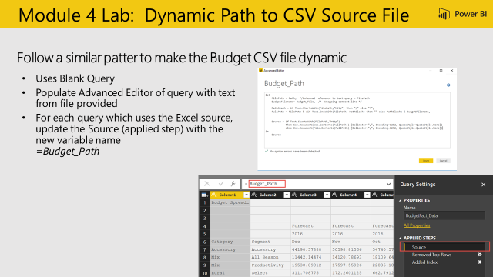
Step by Step
Objective: Update CSV file paths to use dynamic variables
Create a new blank query
Query Name: “Budget_Path”
Copy in text from Budget_Path.txt
Update Source Applied Step to use ResolvedBudgetPath = “Budget_Path” to the following Queries:
BudgetFact
BudgetFact_Data
Student Notes

Slide 15
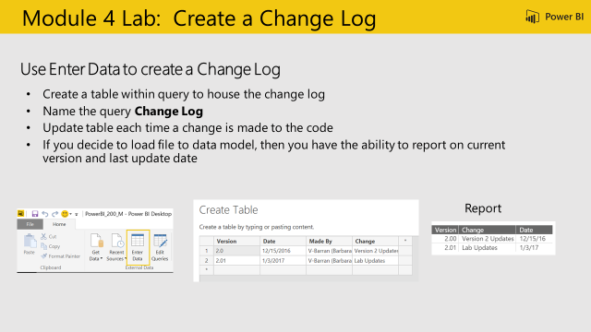
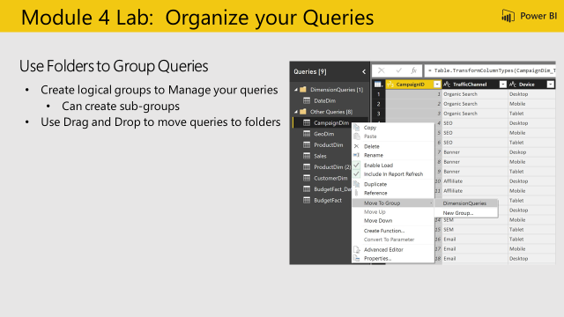
Student Notes
Student Notes

